Slide 1
L3d2
Cu boulder
Csci 3155: principles of programming languages
Summer 2018
Spencer wilson
06/19/2018

Slide 2
PLAN
Q&A before class assignment
Grammars to inference rules to derivations
In class exercise

Slide 3
JOKE

Slide 4
Are functions values?

Slide 5
Are functions Values?
What does this do?
const f = (x) => { return (y) => { return x + y } }
const g = f(2)
g(3)

Slide 6
Are functions Values?
What does this do?
const f = (x) => { return (y) => { return x + y } }
const g = f(2) // (y) => { return 2 + y }
g(3) // 5
f(2)(3) // 5

Slide 7
Disclaimer
I did not check all of those but I am fairly certain that I am correct

Slide 8
Announcements

Slide 9
Practice exam
Practice Exams are live
They are posted on Moodle
I have a few extra hard copies today if needed
These are practice exams. Study first. Then take this exam in test conditions and judge how you did

Slide 10
Weekend study session
I will be in the fishbowl from 11am – 1pm this Saturday to host a review session
You can “zoom” into the event, but that might not work very well.
Ill try to get notes from that session posted online
I will try to get the practice exam solutions out ASAP so that you can review those prior to this Saturday review session

Slide 11
Looking ahead
This week
Lab 2 interviews
Work on Lab 3
Prepare for midterm
Next Week
Take the midterm
Complete Lab 3
Start lab 4 ( a two week lab )
And then
You have Wednesday July 4th off
July 5th go over midterm and review anything you want

Slide 12
Midterm
The midterm is one week from today.
Tuesday June 26, 2018 from 5:00pm – 6:15pm
Note the exam policy in the syllabus (60% exam average required to pass the course)
Those of you with accommodations – please check piazza for a private message from me
Notes:
To be quite serious… If you haven’t done any of these then you are officially behind the ball. I built in some wiggle room here since it is the first week but you should be aware that this is BAD
I will be taking questions on the syllabus in class tomorrow

Slide 13
Questions?
?
Announcements

Slide 14
Questions?
?
Before class assignment

Slide 15
Understanding the inference rule…
Presuming that toNumber casts values to Doubles in the same way that JavaScript would… Why does this inference rule work?
EvalMinus (a rule hidden inside EvalArith)
E |- e₁ ⇓ v₁ E |- e₂ ⇓ v₂ n’ = toNumber(v₁) - toNumber(v₂)
----------------------------------------------------------------------------------------
E |- e₁ – e₂ ⇓ n’

Slide 16
Questions?
?
Why it works

Slide 17
Writing Inference Rules

Slide 18
Language Theory terminology

Slide 19
CFG Terminology
Language : set of sentences
Grammar : set of grammar rules that describe a language
Object-language : The language that I want to describe
JavaScript
Meta-language : The language that I use to describe my object-language
Interpreter level : Scala
Grammar level : CFG in BNF

Slide 20
BNF grammars
The 3 Meta-symbols of BNF are ::= | ϵ
Non-terminals are the things found before the ::= meta-symbol
Terminals are the lexemes/words of your object language/the language that you are describing (don’t need* to know it’s definition)
Productions are what your non-terminals can become
S ::= a | b | S + S is a grammar rule with 3 productions of non-terminal S

Slide 21
Testing Grammar Terminology
S ::= ϵ | 0 S | 1 S
How many grammar rules are there? What are the meta-symbols, terminals, and non-terminals?
How many productions do we have? Is the grammar ambiguous? What is the language defined by this grammar?

Slide 22
One more Grammar Terminology
Meta-variables : a variable that represents an intuitive language
e.g. n represents the language of numbers
e.g. b represents the language of booleans
e.g. str represents the language of strings
e.g. x represents the language of variables

Slide 23
Example Grammar Terminology
S ::= End | n -> S
s.t. n is a meta-variable for numbers
Question : What is the language described by the grammar?

Slide 24
Linked List
S ::= End | n -> S
s.t. n is a meta-variable for numbers

Slide 25
PL specific terminology

Slide 26
Judgment Form - truth
the form of how languages will relate
= + common addition
⇓ big-step evaluation
⟶ small-step evaluation
|- ⇓ big-step with environment

Slide 27
Judgment Form – reasonable lie
The inputs and outputs are typically implied and not written out.
Output = input1 + input2 common addition
Input ⇓ output big-step evaluation
Input ⟶ output small-step evaluation
Input1 |- input2 ⇓ output big-step with environment

Slide 28
Operational Semantic
Combines a judgment form with specific languages to explain some behavior that we want to express
n’ = n₁ + n₂ where n is the language of numbers
e ⇓ v where e are expressions and v are values
e ⟶ e’ where e and e’ are both expressions
E|- e ⇓ v where E is an environment for evaluation

Slide 29
Writing Inference Rules

Slide 30
Inference rules
Terms from PL research and Math research
Uses an operational semantic and any grammars related to languages referenced by that grammar to inductively define how the operation takes place.
Lab 3 has a lot of these to look at

Slide 31
Inference rules
Premise1 … Premise n
--------------------------------------
Conclusion
Axiom : an inference rule with no Premise

Slide 32
Example
S ::= End | n -> S
s.t. n is a meta-variable for numbers
Input ⇓_{sum} Output
S ⇓_{sum} n

Slide 33
Example
S ::= End | n -> S
s.t. n is a meta-variable for numbers
Input ⇓_{sum} Output
S ⇓_{sum} n
The input language is defined by a grammar that has 2 productions so I likely need at least 2 inference rules

Slide 34
Example
Rule 1
--------------------------------
Rule 2
--------------------------------

Slide 35
Example
Rule 1
--------------------------------
⇓_{sum}
Rule 2
--------------------------------
⇓_{sum}

Slide 36
Example
S ::= End | n -> S
s.t. n is a meta-variable for numbers
Input ⇓_{sum} Output
S ⇓_{sum} n

Slide 37
Example
Rule 1
--------------------------------
End ⇓_{sum}
Rule 2
--------------------------------
n -> S ⇓_{sum}

Slide 38
Rule 1
Rule 1
--------------------------------
End ⇓_{sum}
What is the sum of this Linked List of numbers?

Slide 39
Rule 1
Rule 1
--------------------------------
End ⇓_{sum} 0
What is the sum of this Linked List of numbers?

Slide 40
Example
Rule 1
--------------------------------
End ⇓_{sum} 0
Rule 2
--------------------------------
n -> S ⇓_{sum}

Slide 41
Rule 2
Rule 2
--------------------------------
n –> S ⇓_{sum}
What is the sum of this Linked List of numbers?

Slide 42
Rule 2
Rule 2 S ⇓_{sum}
--------------------------------
n –> S ⇓_{sum}
It depends on the sum of S… here I am declaring a premise... It recurses the operation of the form “⇓_{sum}”on S.

Slide 43
Rule 2
Rule 2 S ⇓_{sum} n’
--------------------------------
n –> S ⇓_{sum}
The output is labeled n’. It must be an n. I chose to denote that it is a different n then that of our conclusion by adding an apostrophe.

Slide 44
Rule 2
Rule 2 S ⇓_{sum} n’
--------------------------------
n –> S ⇓_{sum}
Now what is my output?

Slide 45
The Wrong Way…
Rule 2 S ⇓_{sum} n’
--------------------------------
n –> S ⇓_{sum} n + n’
S ⇓_{sum} n
n + n’ DNE in the language of n

Slide 46
Flavor 2 - preferred
Rule 2 S ⇓_{sum} n’ n’’ = n + n’
-------------------------------------
n –> S ⇓_{sum} n’’

Slide 47
Example
Rule 1
--------------------------------
End ⇓_{sum} 0
Rule 2 S ⇓_{sum} n’ n’’ = n + n’
-------------------------------------
n –> S ⇓_{sum} n’’

Slide 48
Rename the rules
SumEmptyLL
--------------------------------
End ⇓_{sum} 0
SumNonEmptyLL S ⇓_{sum} n’ n’’ = n + n’
-------------------------------------
n –> S ⇓_{sum} n’’

Slide 49
Derivations

Slide 50
Sanity check… Do a derivation
Find a sentence that is in the input language (use parse trees to confirm the existance)
Using the judgment form, state a judgment
Using the inference rules, derive the judgment

Slide 51
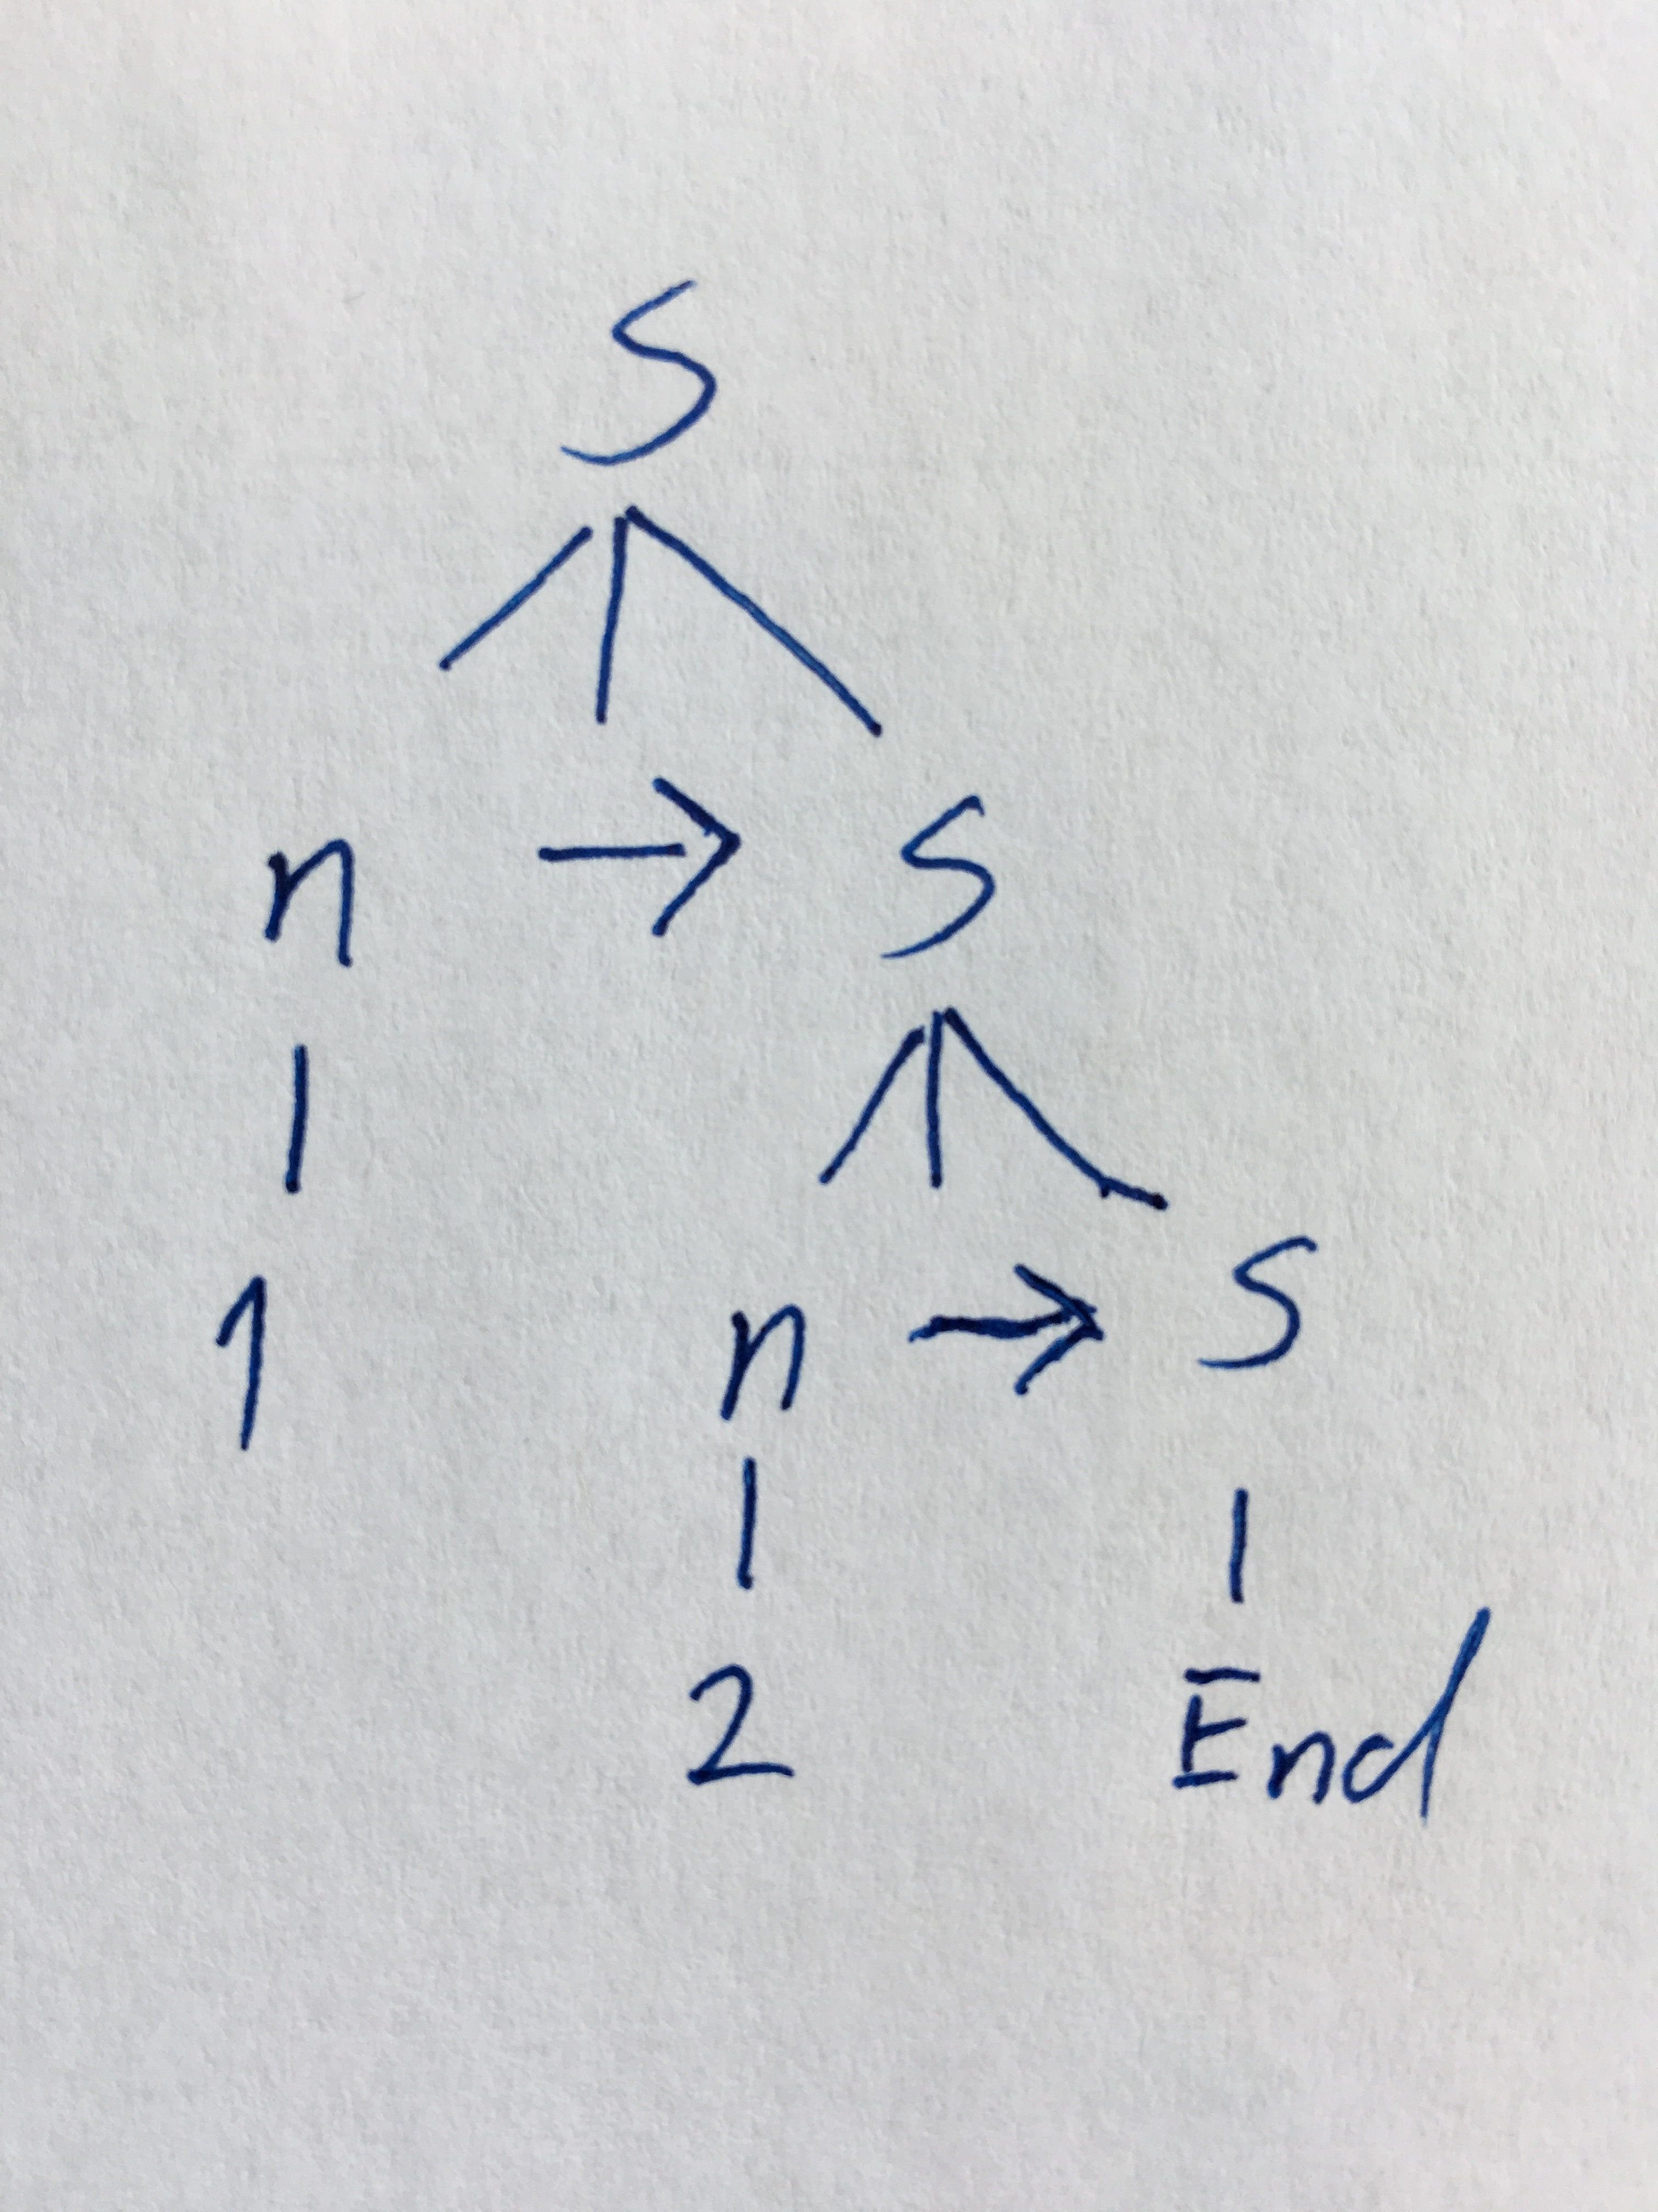
Sanity check… Do a derivation
sentence
Parse tree
Grammar:
S ::= End | n -> S
Sentence:
`1 -> 2 -> End`

Slide 52
Sanity check… Do a derivation
Find a sentence that is in the input language
`1 -> 2 -> End`
Using the judgment form, state a judgment
Using the inference rules, derive the judgment

Slide 53
Sanity check… Do a derivation
Using the judgment form, state a judgment
Judgment form: ⇓_{sum}
Judgment:
1 -> 2 -> End ⇓_{sum} 3

Slide 54
Sanity check… Do a derivation
Find a sentence that is in the input language
`1 -> 2 -> End`
Using the judgment form, state a judgment
1 -> 2 -> End ⇓_{sum} 3
Using the inference rules, derive the judgment

Slide 55
Sanity check… Do a derivation
----------------------------------------------------------SumNonEmptyLL
1 -> 2 -> End ⇓_{sum}

Slide 56
Sanity check… Do a derivation
-------------------------SumNonEmptyLL
2 -> End ⇓_{sum}
-----------------------------------------------------------SumNonEmptyLL
1 -> 2 -> End ⇓_{sum}

Slide 57
Sanity check… Do a derivation
---------------SumEmptyLL
End ⇓_{sum}
--------------------------------SumNonEmptyLL
2 -> End ⇓_{sum}
-----------------------------------------------------------SumNonEmptyLL
1 -> 2 -> End ⇓_{sum}

Slide 58
Sanity check… Do a derivation
---------------SumEmptyLL
End ⇓_{sum} 0
------------------------------------------SumNonEmptyLL
2 -> End ⇓_{sum}
-----------------------------------------------------------SumNonEmptyLL
1 -> 2 -> End ⇓_{sum}

Slide 59
Sanity check… Do a derivation
---------------SumEmptyLL
End ⇓_{sum} 0 = 2 + 0
------------------------------------------SumNonEmptyLL
2 -> End ⇓_{sum}
-----------------------------------------------------------SumNonEmptyLL
1 -> 2 -> End ⇓_{sum}

Slide 60
Sanity check… Do a derivation
---------------SumEmptyLL
End ⇓_{sum} 0 2 = 2 + 0
------------------------------------------SumNonEmptyLL
2 -> End ⇓_{sum}
-----------------------------------------------------------SumNonEmptyLL
1 -> 2 -> End ⇓_{sum}

Slide 61
Sanity check… Do a derivation
---------------SumEmptyLL
End ⇓_{sum} 0 2 = 2 + 0
------------------------------------------SumNonEmptyLL
2 -> End ⇓_{sum} 2
-----------------------------------------------------------SumNonEmptyLL
1 -> 2 -> End ⇓_{sum}

Slide 62
Sanity check… Do a derivation
---------------SumEmptyLL
End ⇓_{sum} 0 2 = 2 + 0
----------------------------------------------SumNonEmptyLL
2 -> End ⇓_{sum} 2 = 1 + 2
-----------------------------------------------------------SumNonEmptyLL
1 -> 2 -> End ⇓_{sum}

Slide 63
Sanity check… Do a derivation
---------------SumEmptyLL
End ⇓_{sum} 0 2 = 2 + 0
----------------------------------------------SumNonEmptyLL
2 -> End ⇓_{sum} 2 3 = 1 + 2
---------------------------------------------------------------SumNonEmptyLL
1 -> 2 -> End ⇓_{sum}

Slide 64
Sanity check… Do a derivation
---------------SumEmptyLL
End ⇓_{sum} 0 2 = 0 + 2
----------------------------------------------SumNonEmptyLL
2 -> End ⇓_{sum} 2 3 = 1 + 2
-----------------------------------------------------------------SumNonEmptyLL
1 -> 2 -> End ⇓_{sum} 3

Slide 65
Does this seem correct?
---------------SumEmptyLL
End ⇓_{sum} 0 2 = 2 + 0
----------------------------------------------SumNonEmptyLL
2 -> End ⇓_{sum} 2 3 = 1 + 2
---------------------------------------------------------------SumNonEmptyLL
1 -> 2 -> End ⇓_{sum} 3

Slide 66
Sanity check… Do a derivation
Find a sentence that is in the input language
`1 -> 2 -> End`
Using the judgment form, state a judgment
1 -> 2 -> End ⇓_{sum} 3
Using the inference rules, derive the judgment
It worked

Slide 67
1 -> 2 -> End ⇓_{sum} 3
Easy as 1 2 3…

Slide 68
Questions?
?
Inference rule process

Slide 69
In class exercise

Slide 70
Try it yourself
S ::= End | n -> S
s.t. n is a meta-variable for numbers
+ ⇓_{increase} OR Input₁ + Input₂ ⇓ _{increase} Output
S + n ⇓ _{increase} S’

Slide 71
Try it yourself
S + n ⇓ _{increase} S’
1 -> 2 -> End + 5 ⇓ _{increase} 6 -> 7 -> End
5 -> 10 -> 15 -> End + 2 ⇓ _{increase} 7 -> 12 -> 17 -> End

Slide 72
Questions?
?
ICE

